Slide 1

FedLM A Review on Federated Learning for Language Models Muhammad Umar Salman umar.salman@mbzuai.ac.ae
Notes:
GM and AOA
First Id lik to introduce mysef
And the topic ill be presenting today is

Slide 2
Agenda
Introduction
Previous Work
Federated Learning
Models
Results
Conclusion + Discussions
2
Notes:
First we’ll be talking about the introduction where we will be looking at the background of our problem
We’ll then move on to the previous work which discusses a few approaches which were used before FL
Then we will see why we need for FL what is FL
After that we will look at a few LM under FL settings
Following that we will look at the results of experiments done by each approach
And finally we will conclude with a brief overview of the key ideas and a few research gaps which could be useul for potential future research

Slide 3
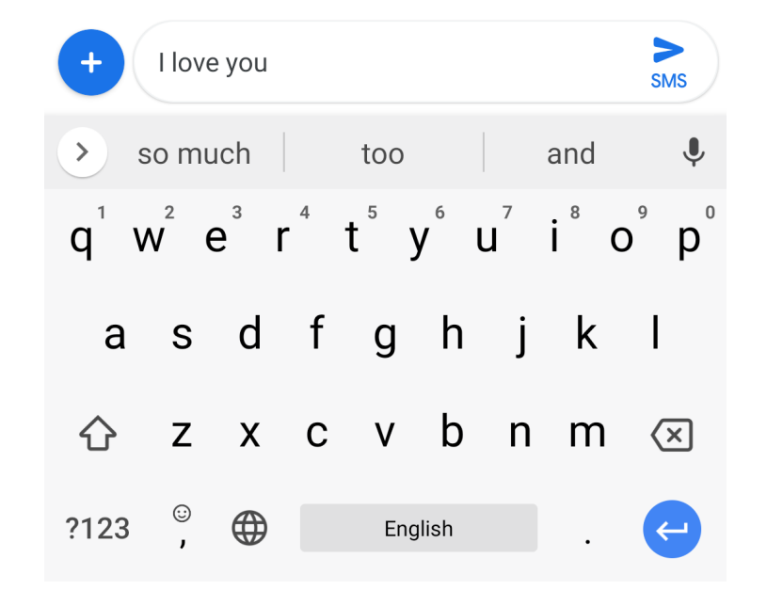
Intro
Previous
Work
Federated
Learning
Models
Results
Conclusion
Introduction
Most textual data is generated on mobile devices
Improve user experience on virtual keyboard (Gboard)
Next-word prediction problems
Figure 1
Source [8]
Figure 2
Source [1]
3
Notes:
As you may know most textual data is generated on mobile platforms such as chat applications or while surfing the web
Thus creating a need to improve user experience by creating effective and efficient language models on mobile virtual keyboards
Google Keyboard Gboard is the most widely used virtual keyboard on android
In the picture on the left we can see Gboard making use of one of NLP’s tasks, Information Retrieval
In this presentation however we will primarily look at next-word prediction problem

Slide 4
Intro
Previous
Work
Federated
Learning
Models
Results
Conclusion
Previous Work
Work
Previously Gboard made prediction through a word n-gram finite state transducer (FST) 1997 [6]
Incease use of RNN-LMs with the advancement of deep learning
Drawback
State-of-the-art RNN-LMs require 50MB+ memory to store 25M parameters
On-device don’t have enough compute or memory capacity to support such large model parameters.
4
Notes:
Previously Gboard made prediction through a word n-gram finite state transducer (FST) which was introduced in
However due to the advancement in deep learning models we see an increase use in RNN-based LMs
And these State-of the-art RNN-LMs gave better next word predictions that FSTs
BUT there is drawback to these
These models require over 50MB of memory to just store around 25M parameters
This is a huge storage cost for a virtual keyboard which is why there is a need to reduce the model size

Slide 5
Intro
Previous
Work
Federated
Learning
Models
Results
Conclusion
Work
To deal with compute and storage bottlenecks an embedded deep learning based word prediction method was introduced in 2017. [7]
Their model size was 7.40MB and had an average prediction time of 6.47ms
Drawback
However, there was still the issue of sensitive data leaving the device of the user to train models
5
Notes:
To deal with this bottleneck of huge storage requirements,
an approach was introduced in 2017 which reduced the model size to under 10MB with a prediction time of around 7ms
BUT again
There still remained an issue of sensitive and private data leaving the users device to train these models

Slide 6
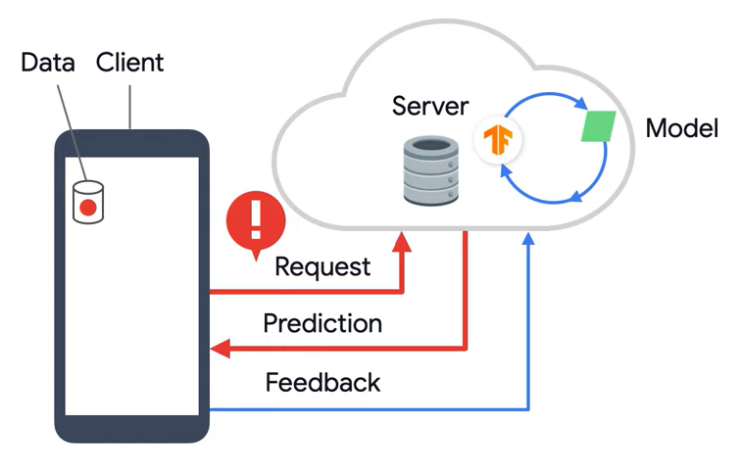
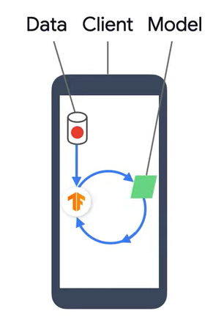


Intro
Previous
Work
Federated
Learning
Models
Results
Conclusion
Federated Learning
Motivation
To train effective and efficient language models on edge devices without exposing a users private data to a centralized server.
Figure 1
Source [9]
Figure 2
Source [9]
Effective
Efficient
Effective
Efficient
6
Notes:
Thus there is a need for FL
As we can see the motivation is that we need
In the first fig you can see the model is on the server and user has to request for a prediction for the next word, this is effective but not effiecient because of latency issues. Most next word predictions are expected under 20ms
The 2nd Fig has a model on the mobile device, this makes it efficient and continuous but not effective as locally trained data isn’t sufficient for good next word prediction

Slide 7
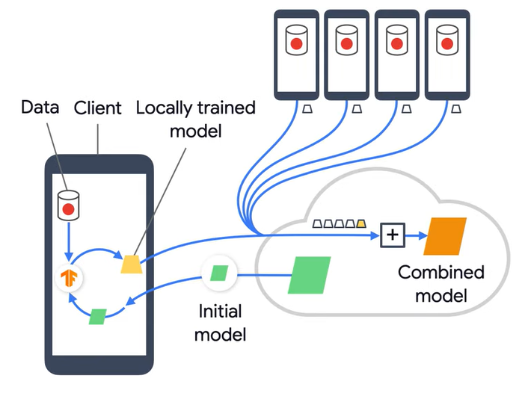
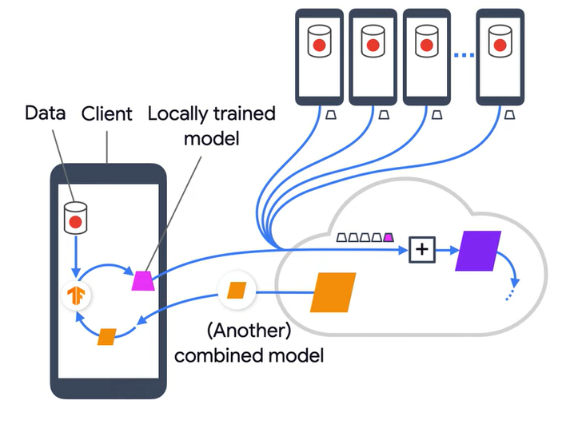
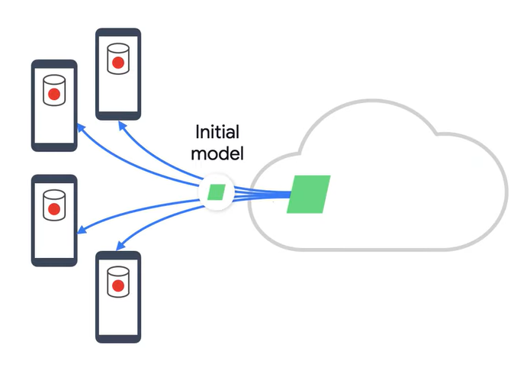
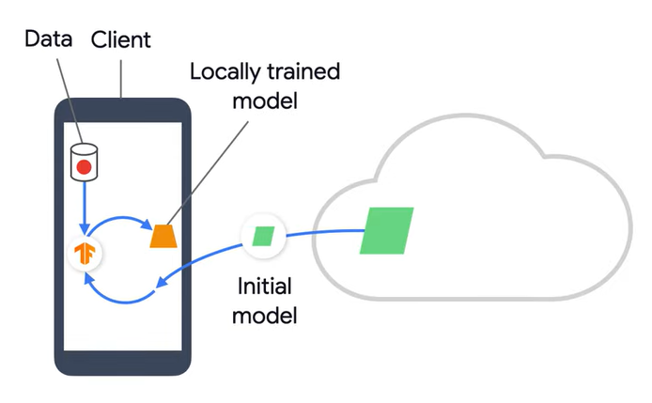
Intro
Intro
Previous
Work
Previous
Work
Federated
Learning
Federated
Learning
Models
Results
Results
Conclusion
Conclusion
Definition
Federated Learning is a decentralized approach which learns personalized models from multiple distributed edge devices without sharing data to a centralized server.
Figure 1
Source [9]
Figure 2
Source [9]
Figure 3
Source [9]
Figure 4
Source [9]
7
Notes:
So how does FL work we define FL as …
This approach not only addresses the privacy issue but also deals with the limited compute capacity and latency issues on edge devices
So how does a FL model work
(click)
First an initial model is deployed to multiple selected devices
(click)
Here the models are trained on locally trained data
(click)
Then each device sends its client updates or weight parameters to an agg function on the server which creates a combined model
(click)
On the server it is further trained it and sends the newly updated combined model back onto the edge device

Slide 8
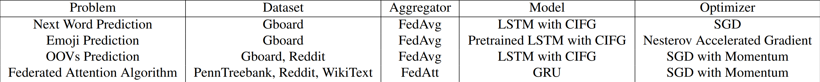
Intro
Previous
Work
Federated
Learning
Models
Results
Conclusion
Models
Federated learning for mobile keyboard prediction. (2018) [1]
Federated learning for emoji prediction in a mobile keyboard (2019) [2]
Federated learning of out-of-vocabulary words (2019) [3]
Learning private neural language modeling with attentive aggregation (2019) [4]
8
Notes:
Here we will look at 4 different approaches which use LM under FL setting

Slide 9
1. Federated learning for mobile keyboard prediction
Intro
Previous
Work
Federated
Learning
Models
Results
Conclusion
METHOD
LSTM using CIFG (Control Input and Forget Gate) [5].
Uses FedAvg as aggregator.
PROBLEM
Predict next word while not allowing private data to be transferred out
Reducing storage & compute cost.
M
P
Outperforms server trained CIFG models
Reduces parameter size by 25%.
STRENGTH
Requires a lot of federated training rounds which leads to high communication costs.
WEAKNESS
S
W
Notes:
This approach uses an LSTM with CIFG
The problem its trying to solve is the basic FL problem
CIFG architecture gives a great advantage to mobile platforms as they, without any loss in performance, manage to significantly reduce the parameter size by 25% as well as lowering the LMs complexity and inference time latency.
The CIFG structure comprises of a single gate which controls both the input and recurrent cell self-connections

Slide 10
2. Federated learning for emoji prediction in a mobile keyboard
Intro
Previous
Work
Federated
Learning
Models
Results
Conclusion
METHOD
Uses a pre-trained LSTM using CIFG model
Triggering model to predict if a word or an emoji is next.
PROBLEM
Predict most suitable emoji given text.
Distinguish whether to predict word or emoji
M
P
Outperform the pre-trained server-based CIFG model
STRENGTH
Gboard’s dataset distribution of emojis is light-tailed
Likely to predict the more frequent emojis
WEAKNESS
S
W
Notes:
The 2nd approach attempts to predict the most suitable emoji given text
Gboard’s dataset distribution of emojis is very light-tailed thus more likely to predict the more frequent emojis
e emoji where the next word

Slide 11
3. Federated learning of out-of-vocabulary words
Intro
Previous
Work
Federated
Learning
Models
Results
Conclusion
METHOD
Uses character-level LSTM.
OOV words are Monte-Carlo sampled for prediction
PROBLEM
Predict frequently used unknown words
M
P
Incorporates unknown frequently used words for next word predictions.
STRENGTH
Frequent unintended typos might be sampled.
WEAKNESS
S
W
Notes:
The next approach uses character-level LSTM with peephole connections to learn OOV words.
The Oovs are then mote-carlo sampled for prediction
The problem it is trying to solve is trying to predict frequently unknown words such as slang, abbr and proper nouns
The major strength of this method is incorporating unknown words into next word predictions
However a drawback for this approach is frequent unintended typos might be sampled and shown to user as next word suggestion.

Slide 12
4. Learning private neural language modeling with attentive aggregation.
Intro
Previous
Work
Federated
Learning
Models
Results
Conclusion
METHOD
FedAtt as aggregator
GRU model
PROBLEM
Introduces attention mechanism for model aggregation
M
P
Fewer communication rounds compared to FedAvg. STRENGTH
None mentioned or could be inferred.
WEAKNESS
S
W
Notes:
This method introduces a new aggregator function called attentive Federated algo which makes use of the attention mechanism for aggregation of client updates.
The model uses a special case of LSTM called GRU
And tests its results on 3 different datasets
No weakness was mentioned in the paper nor could any weakness be inferred for this new technique
However it reduced the communication rounds for training the model compared to FedAvg

Slide 13
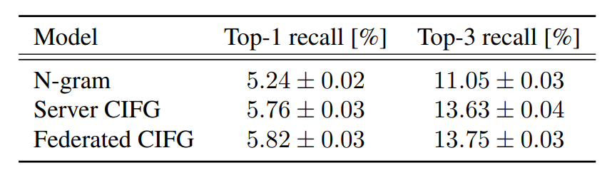
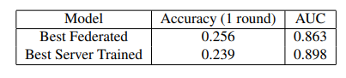
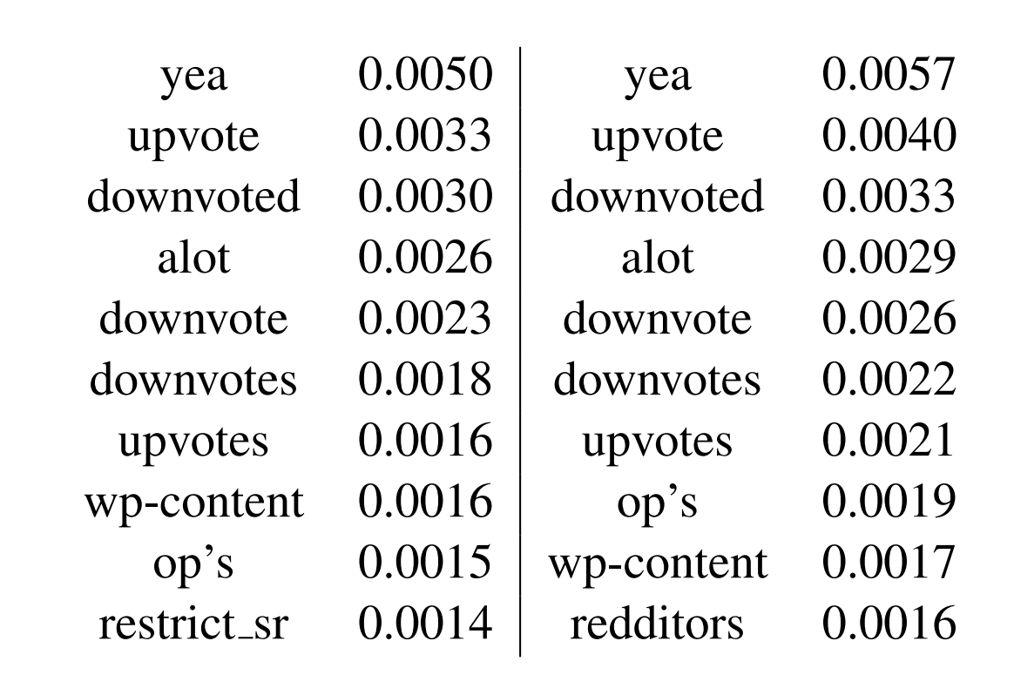
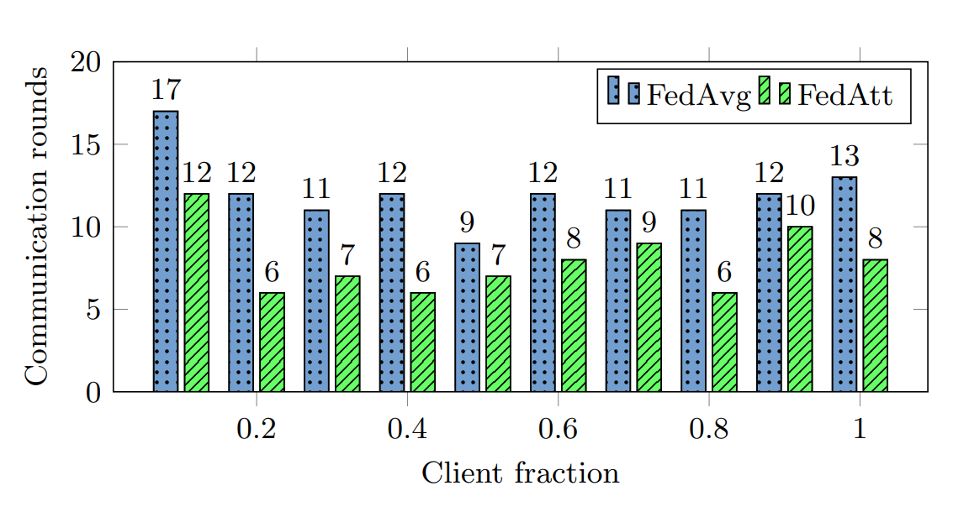
Intro
Previous
Work
Federated
Learning
Models
Results
Conclusion
Results
Table 2
Source [2]
Table 1
Source [1]
Figure 1 Source [4]
Figure 2
Source [3]
13
Notes:
As you can see that none of these models are comparable on a certain evaluation metric
Looking at the results of our first approach we can see that FL approach does much better than server trained approach in terms of recall
The same can be seen on 1 round training of for emoji + word prediction
Figure 1 also shows the communication rounds used in FedAvg and FedAtt for different number of clients. Where FedAtt always has fewer number of communication rounds
In Fug 2 we can see the Top 10 out-of-vocabulary words and probability, where on the left is the Reddit dataset ground truth and on the right is the probabilities using FL

Slide 14
Intro
Previous
Work
Federated
Learning
Models
Results
Conclusion
Conclusion + Discussion
Conclusion + Discussion
4 approaches solve 4 different problems
Outperform server-based trained results without exposing any data.
¾ models reduce parameters size using CIFG
FedAtt reduces communication rounds solving the latency issue.
Research Gaps
No transformer-based LM in federated learning settings.
Lack of use of advanced privacy and data preserving techniques for securing users data
14
Notes:
Given the recent success of transformer-based LMs in other NLP tasks, we couldn’t find any work relevant to federated learning.
Methods lack use of advanced privacy and data preserving techniques for the security of a user’s data on the virtual keyboard platform

Slide 15
References
A. Hard, et al. Federated learning for mobile keyboard prediction. 2018.
S. Ramaswamy, et al. Federated learning for emoji prediction in a mobile keyboard. 2019.
M. Chen, et al. Federated learning of out-of-vocabulary words. 2019.
S. Ji, et al. Learning private neural language modeling with attentive aggregation. 2019.
K.Greff, et al. Lstm: A search space odyssey. 2016.
M. Mohri. Finite-state transducers in language and speech processing. 1997.
S. Yu, et al. An embedded deep learning based word prediction. 2017.
https://ai.googleblog.com/2017/04/federated-learning-collaborative.html
https://www.tensorflow.org/federated.
15

Slide 16
Thank you
Questions?
Muhammad Umar Salman
umar.salman@mbzaui.ac.ae

